Slide 1
Radiofrequency Pulses in MRI
Lecture 2
Mahesh Keerthivasan
BME 639
University of Arizona

Slide 2
Review
Main
Field
Bo
z
North
z
B1(t)
B1
M₀
y
y
Applied B1 RF Field
x
M₀
x
The RF pulse rotates Mo the about applied field
Adapted from Larry Wald’s slides, fMRI MR Physics

Slide 3
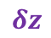
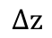
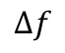

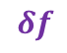
Review
High frequency carrier wave modulated by low frequency RF pulse to generate B1 field
Flip angle $θ$ : controls tip angle of magnetization
$$δf$$
$$Δf$$
$$δz$$
$$Δz$$
Adapted from MRI from Picture to Proton. Cambridge: Cambridge University Press

Slide 4

Review
Using Bloch equations and small flip angle approximation we can find the distribution of flip angles across the excited slice
Achieved by measuring the transverse magnetization
Slice profile is approximately equal to inverse Fourier transform of RF pulse
$$M_{xy}\left(t\right)=iM_{0}γe^{−i Δωt}\int_{t^{′}=0}^{t}{B1\left(t′\right)e^{iΔωt^{′}}dt′}$$

Slide 5
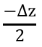
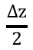
RF Pulse Slice Profile
Fourier Transform
Ideal slice profile
Flip angle
For a finite slice profile we require an infinite duration sinc pulse !
$$\frac{−Δz}{2}$$
$$\frac{Δz}{2}$$
$$z$$
https://www.chem.purdue.edu/courses/chm621/text/ft/basiset/rect/rect.htm

Slide 6
RF Pulse Slice Profile
Slice profiles for a 30º RF pulse
(0.523 radians)

Slide 7
RF Pulse Slice Profile
Slice profiles for a 30º RF pulse
(0.523 radians)

Slide 8
RF Pulse Slice Profile
Slice profiles for a 30º RF pulse
(0.523 radians)

Slide 9
RF Pulse Slice Profile
Slice profiles for a 30º RF pulse
(0.523 radians)

Slide 10
RF Pulse Slice Profile
FT
x
*
Modulation property

Slide 11
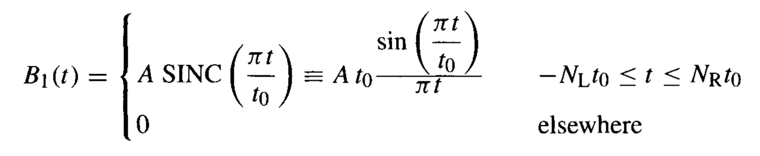





RF Pulse Design: Sinc
Sinc function:
$N_{L}, N_{R}$: Number of zeros crossing of the sinc
$t_{0}$: first zero crossing
$$Δf≈1/t_{0}$$
$$N_{L},=N_{R}=10$$
$$N_{L},=N_{R}=5$$
Time-Bandwidth product:
$$T Δf=N_{L}+N_{R}$$
Handbook of MRI Pulse Sequences, Bernstein

Slide 12
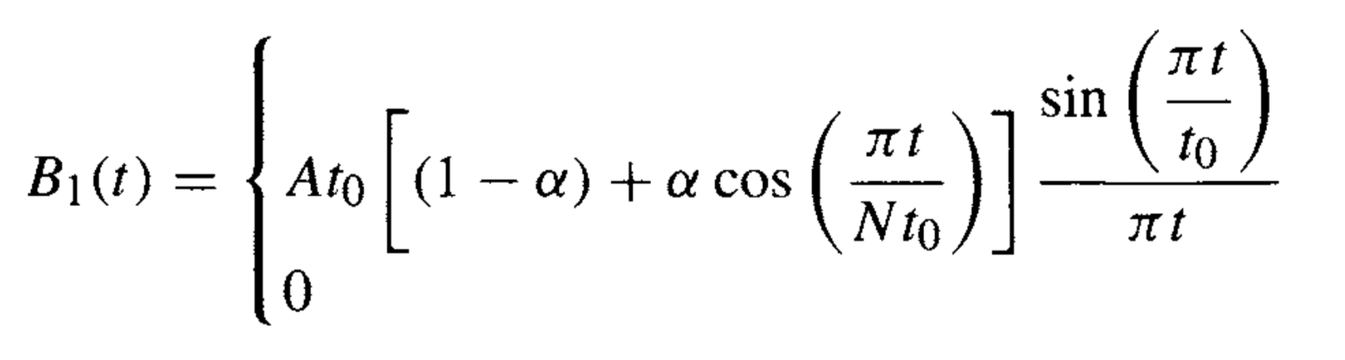
RF Pulse Design: Sinc
Windowed RF Pulse:
Multiple the RF pulse function by an appropriate window function to taper the RF amplitude at the beginning and end
Enable smooth roll off in slice profile
window function w(t)
sinc(t)
Handbook of MRI Pulse Sequences, Bernstein
Notes:
- Depending on value of alpha can be Hanning (0.5) or hamming (0.46)

Slide 13
RF Pulse Design: Sinc
Sinc RF
Windowed Sinc RF

Slide 14
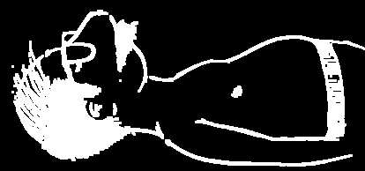
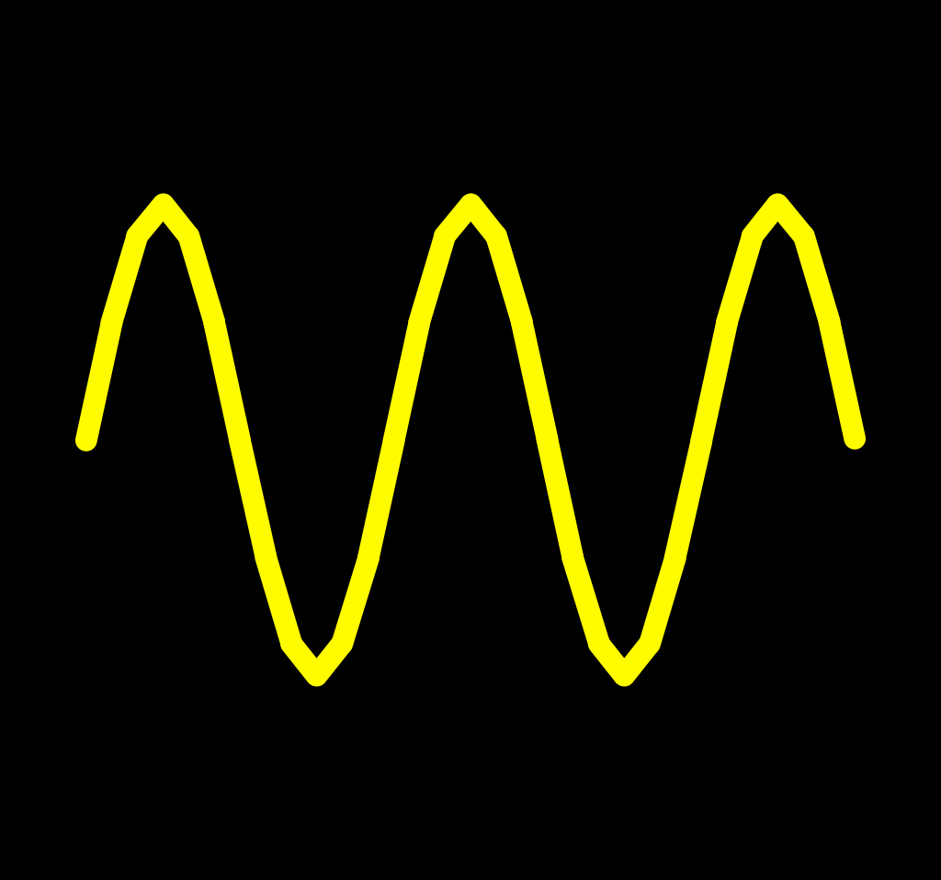
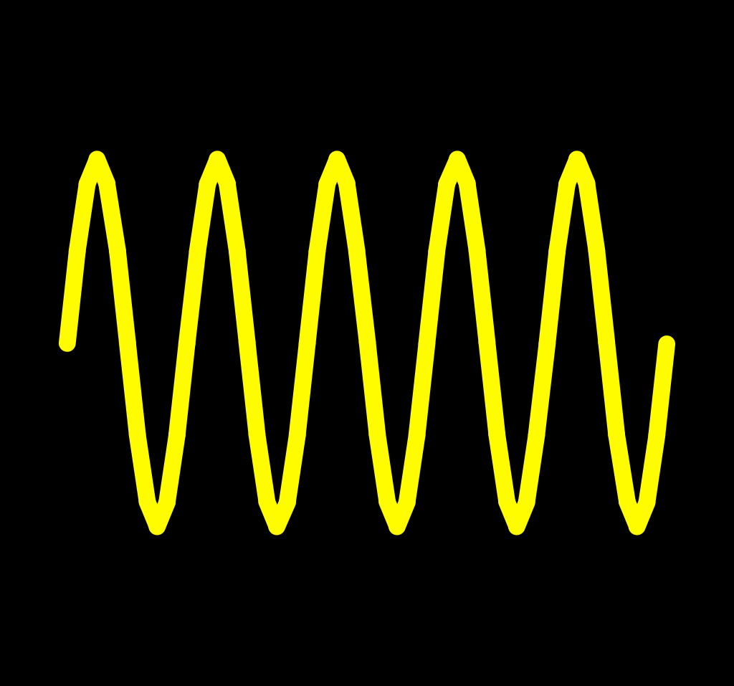
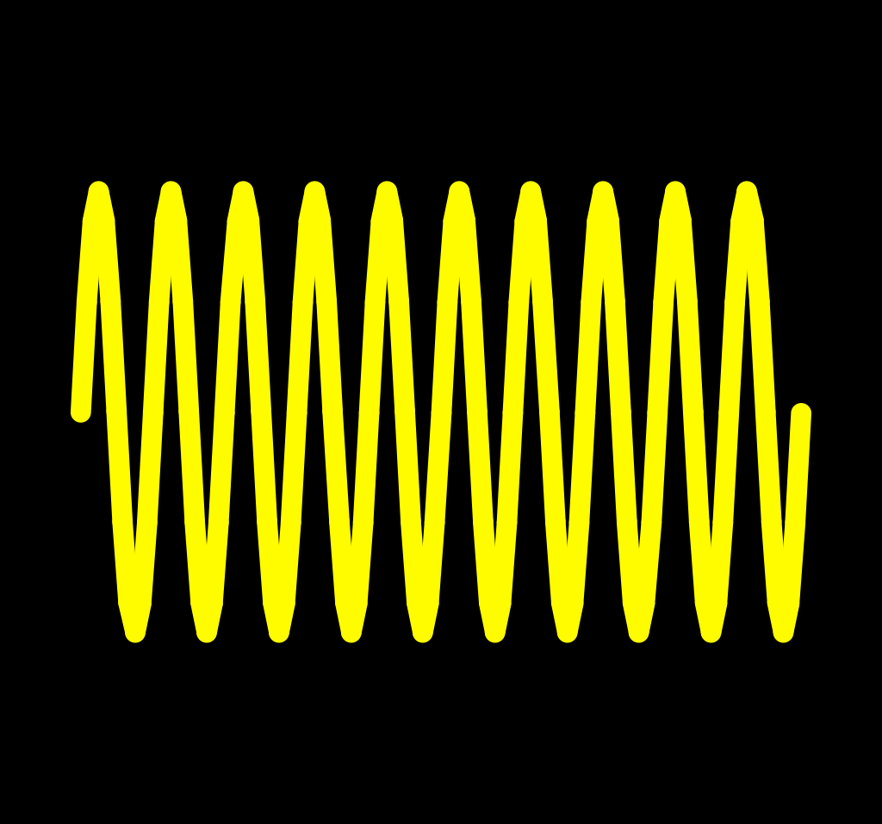
RF Pulse Design: Hard Pulse
Can we excite the entire volume ?
Bo
Bo
Slides from Dr. Nan-kuei Chen
Notes:
Why would we want to excite the entire volume ?

Slide 15

RF Pulse Design: Hard Pulse
Hard pulses: rectangular shaped RF pulse played without slice select gradients
Needs to have a broad bandwidth to excite spins with wide range of frequencies
For an infinite slice profile we require a very narrow RF pulse !
Hard pulses are typically few hundred micro-seconds in duration
$Δf=1.21/T$
Flip angle $θ=γB1 T$
https://www.chem.purdue.edu/courses/chm621/text/ft/basiset/rect/rect.htm

Slide 16
Simultaneous Multi-slice Excitation
So far, excite multiple slices sequentially by changing RF frequency
Can we excite multiple slices simultaneously ?

Slide 17
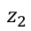
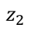
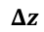
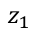
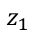
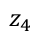
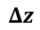
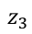
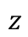
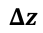
Simultaneous Multi-slice Excitation
Slice profile when exciting one slice
Slice profile when simultaneously exciting two slices
Flip angle
Flip angle
$$z_{1}$$
$$z_{2}$$
$$z$$
$$z_{1}$$
$$z_{2}$$
$$z_{3}$$
$$z_{4}$$
$$z$$
$$Δz$$
$$Δz$$
$$Δz$$
?

Slide 18
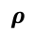
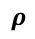
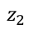
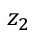
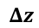
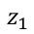
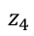
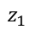
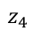
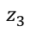
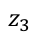
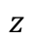
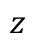
Simultaneous Multi-slice Excitation
Flip angle
Flip angle
$$z_{1}$$
$$z_{2}$$
$$z$$
$$Δz$$
+
Flip angle
$$z_{1}$$
$$z_{2}$$
$$z_{3}$$
$$z_{4}$$
$$z$$
$$Δz$$
$$Δz$$
$$ρ$$
$$z_{3}$$
$$z_{4}$$
$$z$$
$$Δz$$
$$ρ$$

Slide 19
Simultaneous Multi-slice Excitation
Fourier Transform Shift property
Multiplication by complex exponential function
Shift in frequency

Slide 20
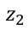

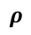
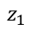
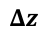
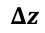
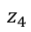
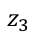
Simultaneous Multi-slice Excitation
Flip angle
$$z_{1}$$
$$z_{2}$$
$$z$$
$$Δz$$
+
Flip angle
*
$$e^{iρt}$$
$$z_{3}$$
$$z_{4}$$
$$z$$
$$Δz$$
$$ρ$$

Slide 21

Simultaneous Multi-slice Excitation
$$B1\left(t\right)=sinc\left(at\right)+sinc\left(at\right)e^{iρt}$$
Multi-band excitation offers $\sqrt{N}$ boost in SNR when simultaneously exciting N slices

Slide 22
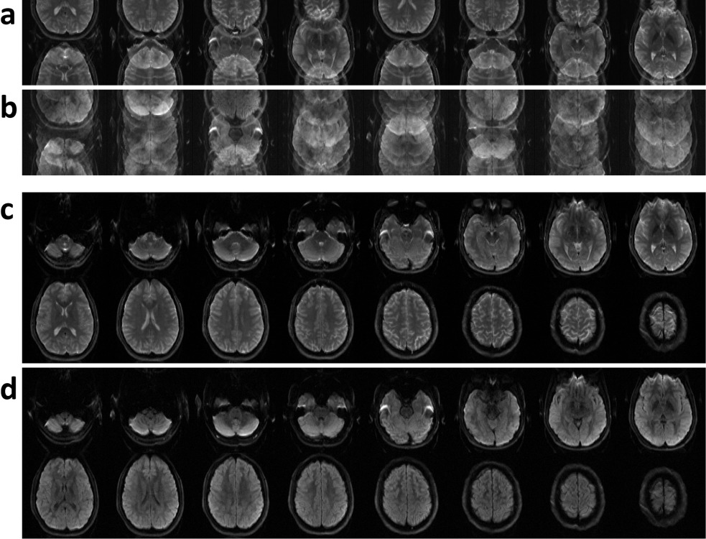
Simultaneous Multi-slice Excitation
Interleaved diffusion-weighted improved by adaptive partial-Fourier and multiband multiplexed sensitivity-encoding reconstruction. Magn Reson Med. 2015: 73(5):1872-84.

Slide 23
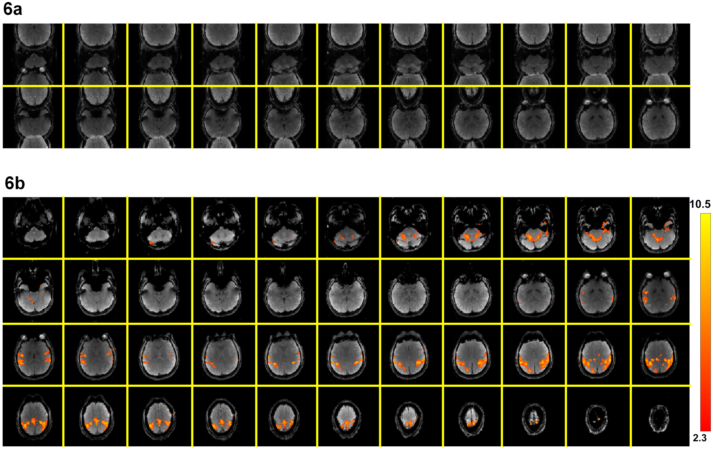
Simultaneous Multi-slice Excitation
Interleaved EPI based fMRI improved by multiplexed sensitivity encoding (MUSE) and simultaneous multi-band imaging. PLoS One. 2014 Dec 30;9(12):e116378
Interleaved EPI based fMRI improved by multiplexed sensitivity encoding (MUSE) and simultaneous multi-band imaging. PLoS One. 2014 Dec 30;9(12):e116378
Interleaved EPI based fMRI improved by multiplexed sensitivity encoding (MUSE) and simultaneous multi-band imaging. PLoS One. 2014 Dec 30;9(12):e116378

Slide 24
RF Design: VERSE
Can the slice select gradient be time varying ?
Variable rate selective excitation (VERSE) : RF pulse with time varying slice select gradient
Used to reduce RF power deposition by decreasing RF amplitude at the peak of pulse
Gs
Gs
Notes:
- Z related to resonant frequency

Slide 25
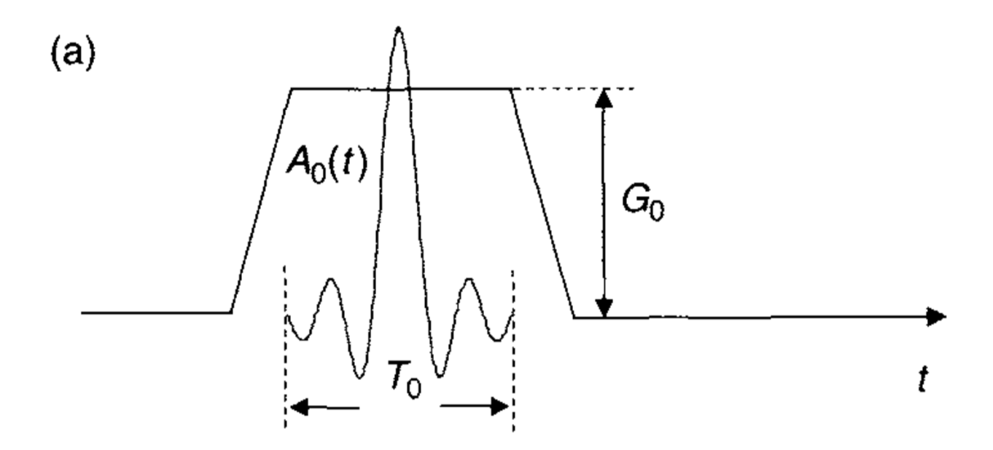
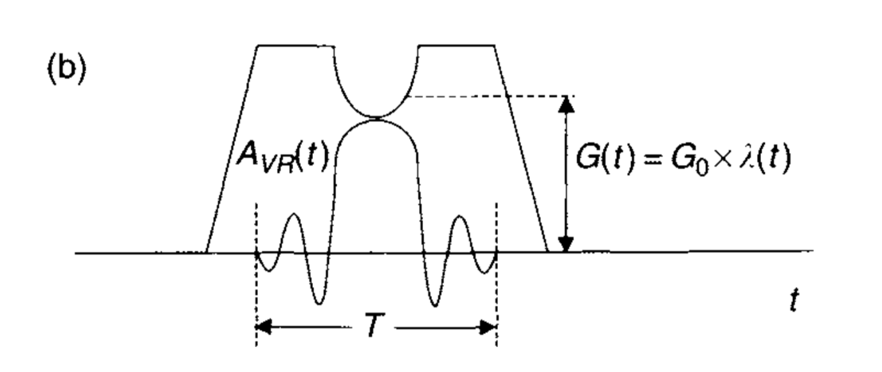
RF Design: VERSE
Handbook of MRI Pulse Sequences, Bernstein
Notes:
- Z related to resonant frequency

Slide 26
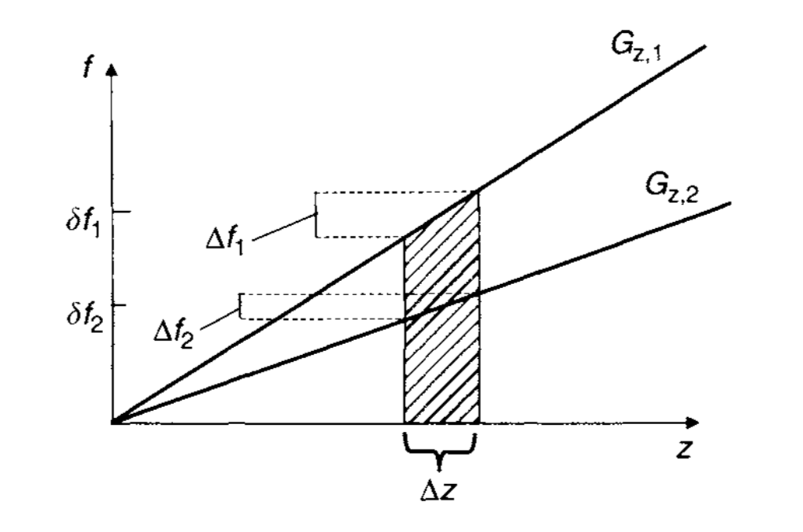


RF Design: VERSE
Duration of VR pulse increased to maintain flip angle
This reduces RF bandwidth of portion that is stretched
Slice select gradient is reduced to maintain same slice profile
$$G\left(t\right)=\frac{2 π Δf_{0}λ(t)}{γΔz}$$
$λ(t)$: reduction factor in RF amplitude
Handbook of MRI Pulse Sequences, Bernstein
Notes:
- Z related to resonant frequency

Slide 27
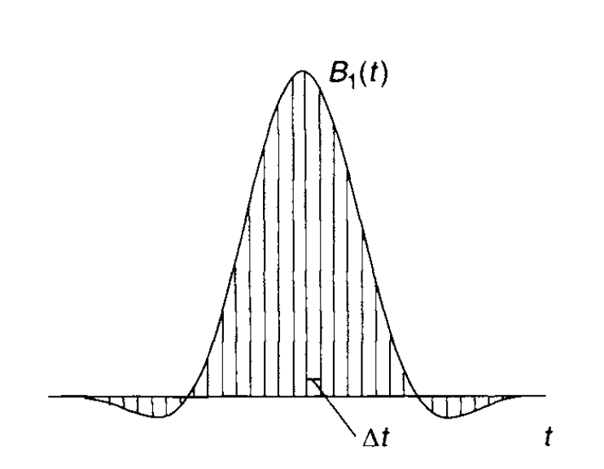
RF Design: SLR
Given a slice profile can we design the corresponding RF pulse ?
For small flip angles < 30º the inverse Fourier transform can be used
For larger flip angles SLR algorithm (Shinnar-Le Roux)
Hard pulse approximation
Handbook of MRI Pulse Sequences, Bernstein
Interleaved EPI based fMRI improved by multiplexed sensitivity encoding (MUSE) and simultaneous multi-band imaging. PLoS One. 2014 Dec 30;9(12):e116378
Interleaved EPI based fMRI improved by multiplexed sensitivity encoding (MUSE) and simultaneous multi-band imaging. PLoS One. 2014 Dec 30;9(12):e116378

Slide 28
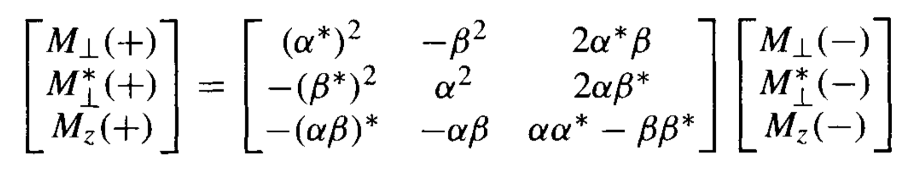
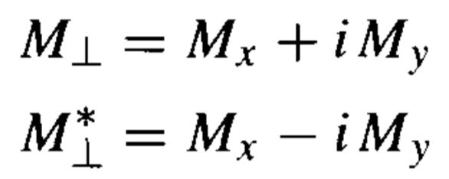

RF Design: SLR
Effect of RF pulse on magnetization can be characterized by a rotation matrix:
$α,β$: Cayley-Klein parameters
Captures non-linearities of Bloch equations
Ignores relaxation effects
Handbook of MRI Pulse Sequences, Bernstein
Interleaved EPI based fMRI improved by multiplexed sensitivity encoding (MUSE) and simultaneous multi-band imaging. PLoS One. 2014 Dec 30;9(12):e116378
Interleaved EPI based fMRI improved by multiplexed sensitivity encoding (MUSE) and simultaneous multi-band imaging. PLoS One. 2014 Dec 30;9(12):e116378

Slide 29

RF Design: SLR
Forward SLR Transform:
Using hard pulse approximation decompose effect of shaped RF pulse to series of rotations
Final magnetization is result of multiplying the individual rotation matrices
Series of hard pulses produce same flip angle as soft pulse
Handbook of MRI Pulse Sequences, Bernstein
Interleaved EPI based fMRI improved by multiplexed sensitivity encoding (MUSE) and simultaneous multi-band imaging. PLoS One. 2014 Dec 30;9(12):e116378
Interleaved EPI based fMRI improved by multiplexed sensitivity encoding (MUSE) and simultaneous multi-band imaging. PLoS One. 2014 Dec 30;9(12):e116378

Slide 30


RF Design: SLR
Forward SLR Transform:
Recursively decompose nutation and precession effect of RF pulse to two complex polynomials $A_{N}, B_{N}$
Polynomials are related to Cayley-Klein parameters
Use the rotation matrix representation to compute the resultant magnetization
Handbook of MRI Pulse Sequences, Bernstein
Interleaved EPI based fMRI improved by multiplexed sensitivity encoding (MUSE) and simultaneous multi-band imaging. PLoS One. 2014 Dec 30;9(12):e116378
Interleaved EPI based fMRI improved by multiplexed sensitivity encoding (MUSE) and simultaneous multi-band imaging. PLoS One. 2014 Dec 30;9(12):e116378
Notes:
- Z related to resonant frequency

Slide 31

RF Design: SLR
Inverse SLR Transform:
Generate the polynomials based on the desired slice profile using Parks- McClellan algorithm
Flip angle, percent ripple in passband and stopband
Translate the two polynomials to the individual RF pulse elements recursively
Allows recovery of entire hard pulse approximation
45º flip angle RF pulse with 2% ripple in passband and stopband
Handbook of MRI Pulse Sequences, Bernstein
Notes:
- Z related to resonant frequency

Slide 32

RF Design: Excitation k-space
Back to the small tip angle approximation :
$M_{xy}\left(r\right) = iM_{0}\int_{0}^{T}{γB_{1}(τ}) e^{i 2π k\left(τ\right). r } dτ$
where, $k(τ)= −γ/2π \int_{τ}^{T}{G\left(s\right) ds}$
Excitation k-space
Describes a path through spatial frequency space
John Pauly, A k-space analysis of small tip angle excitation, 1989

Slide 33




RF Design: Excitation k-space
$$k(τ)= −γ/2π \int_{τ}^{T}{G\left(s\right) ds}$$
Location in k-space at time $τ$ is integral of remaining gradient waveform
Reach origin of k-space halfway through positive lobe of gradient
Refocusing lobe brings back to origin
John Pauly, A k-space analysis of small tip angle excitation, 1989

Slide 34


RF Design: Excitation k-space
RF design involves selecting:
the magnetization response (slice profile)
the excitation k-space trajectory
G$\left(t\right)=\frac{2π}{γ}\frac{dk\left(t\right)}{dt}$
$$B_{1}\left(t\right) =\left|\frac{dk\left(τ,t\right)}{dt}\right| \left|\left|Δk\right|\right| \int_{r}{M_{xy}\left(r\right) }e^{i 2π k\left(τ,t\right). r } dr$$
This method works for flip angles upto 90º
Rate of excitation k-space traversal
Sampling density correction

Slide 35


RF Design: 2D RF
Two dimensional excitation
Handbook of MRI Pulse Sequences, Bernstein

Slide 36




RF Design: 2D RF
2D Excitation Profile
K-space trajectory
K-space trajectory and Gradient waveform
John Pauly, A k-space analysis of small tip angle excitation, 1989
EE469B: RF Pulse Design for MRI, Stanford University
RF Pulse
Handbook of MRI Pulse Sequences, Bernstein

Slide 37
RF Design: 2D RF
A Cylindrical, Inner Volume Selecting 2D-T₂-Prep Improves GRAPPA-Accelerated Image Quality in MRA of the Right Coronary Artery. Andrew J. Coristine, Jerome Yerly, Matthias Stuber , Plos One, October 2016

Slide 38
RF Design: 2D RF
Mitsouras D, Mulkern RV, Rybicki FJ. Strategies for inner volume 3D fast spin echo magnetic resonance imaging using non-selective refocusing radio frequency pulses. Medical physics. 2006;33(1):173-186.

